Slide 1
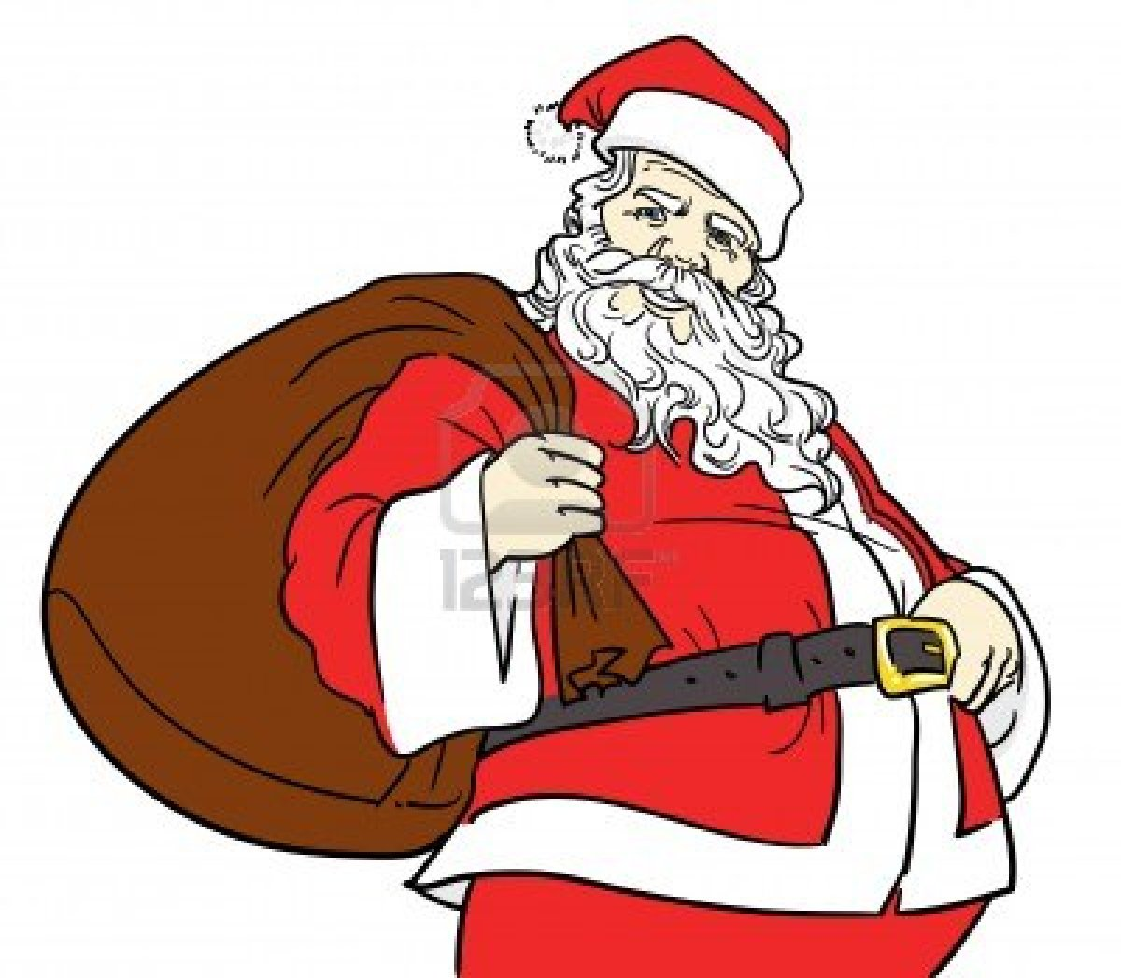
Functional Grammar
What is a clause?
?

Slide 2
A clause -
We could say that a clause represents a slice of experience.

Slide 3
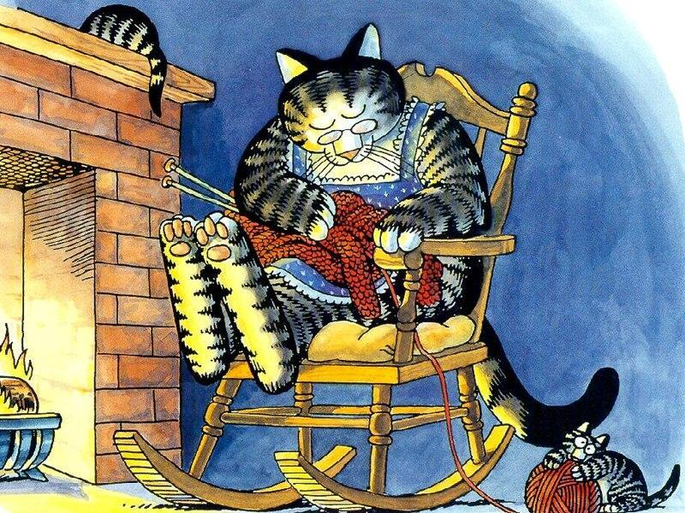
WHEN?
WHERE?
HOW?
WHY?
etc
‘WHAT’S HAPPENING?’
WHEN?
WHERE?
HOW?
WHY?
etc
‘WHO/WHAT
ARE TAKING PART?’
‘WHO/WHAT
ARE TAKING PART?’
LAST NIGHT
OLD GRANNY CAT
WAS KNITTING
A SCARF
BY THE FIRE
CIRCUMSTANCE
PARTICIPANT
PROCESS
PARTICIPANT
CIRCUMSTANCE
CLAUSE
When looking at functional grammar we focus on the function of each chunk of meaning and the different job it does.
For example; we start focusing on the following questions.
What is happening?
Who or what is participating?
Where is it happening?
The terms given to the different parts of the clause reflect the function that happens. For example
The process taking place
The participants
Other circumstances such as (when, where, how and why)

Slide 4
WHEN?
WHERE?
HOW?
WHY?
etc
‘WHAT’S HAPPENING?’
WHEN?
WHERE?
HOW?
WHY?
etc
‘WHO/WHAT
ARE TAKING PART?’
‘WHO/WHAT
ARE TAKING PART?’
CIRCUMSTANCE
PARTICIPANT
PROCESS
PARTICIPANT
CIRCUMSTANCE
What is happening?
Who or what is participating?
Where is it happening?
The process taking place
The participants
Other circumstances such as (when, where, how and why)
CLAUSE
In the morning the children played under the taps.
The three little wolves were playing croquet in the garden.

