Slide 1
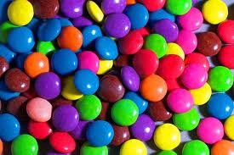
How can Smarties help us learn about Chance and Data?

Slide 2
You will need to write your answers in your Maths book on a new page.

Slide 3
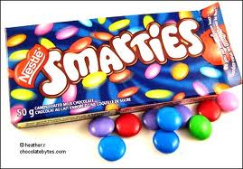
Without opening your Smarties packet predict what colours you might be able to select from the packet.

Slide 4
Open your Smarties packet and sort the colours you have into groups. List what colours you have, is there any difference to your predictions?

Slide 5
Now place your Smarties in order from the colour least likely to be chosen if you closed your eyes and selected one, to the most likely to be chosen.

Slide 6
Can you now explain to your face partner pair why you have ordered the colours in a particular way?

Slide 7
As a whole group can you use numbers to say how likely each colour is to get? What do you need to know?

Slide 8
As a whole group can you use the numbers and place them on a numberline in order?

Slide 9
Now discuss whether both pairs chances of getting a red Smarty is equally likely? Continue this with the other colours that are present. Explain reasons for your results.

